Slide 1
Second Year B. Tech. Advanced Data Structures (CS228)
By
Dr. Pramod D. Ganjewar
Senior Assistant Professor,
School of Computer Engineering,
MIT Academy of Engineering, Alandi(D.),Pune

Slide 2
Unit – 1 Trees m - ary Tree

Slide 3
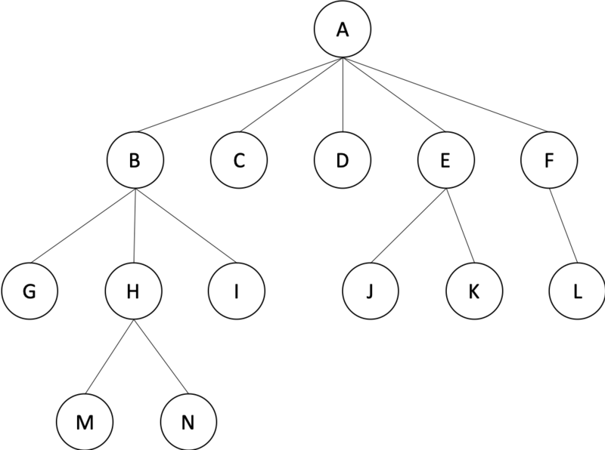
m – ary Tree
m – ary Tree
In graph theory, an m-ary tree (also known as k-ary or k-way tree) is a rooted tree in which each node has no more than m children.
A binary tree is the special case where m = 2, and a ternary tree is another case with m = 3 that limits its children to three.
Example of a m-ary tree with m=5

Slide 4
Types of m – ary Tree
A full m-ary tree is an m-ary tree where within each level every node has either 0 or m children.
A complete m-ary tree is an m-ary tree which is maximally space efficient. It must be completely filled on every level except for the last level. However, if the last level is not complete, then all nodes of the tree must be "as far left as possible".
A perfect m-ary tree is a full m-ary tree in which all leaf nodes are at the same depth.

Slide 5
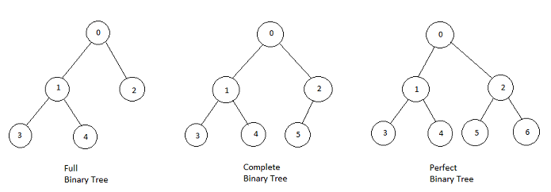
Examples of m – ary Tree

Slide 6
Sequential and Linked Organization of m – ary Tree
Consider m-ary tree as shown in example.
Consider m= 3.
Convert this m-ary tree to complete m-ary tree.
Assign index to all the nodes.
Assign index = 0 to root node.
Go on assigning the next index level by level from left side.
Apply this to all the nodes in the tree.
You will get complete m-ary tree as shown in example.

Slide 7
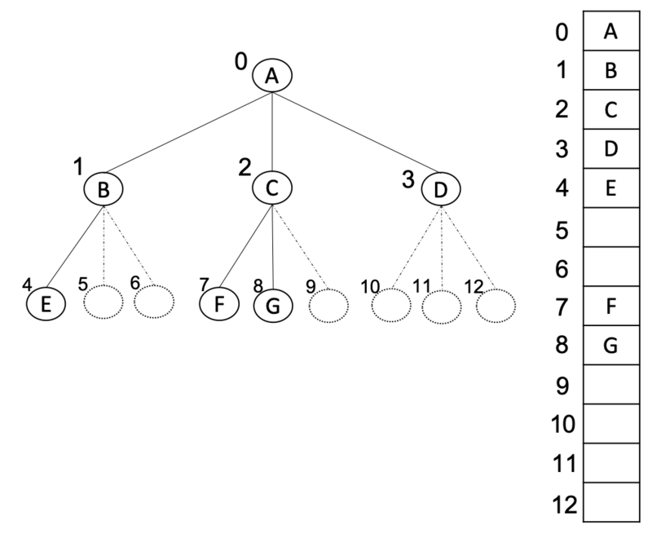
Sequential Organization / Representation of m – ary Tree

Slide 8
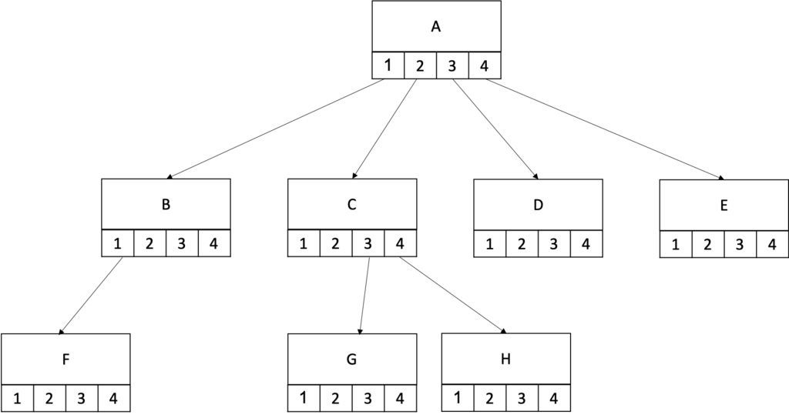
Linked Organization / Representation of m – ary Tree

Slide 9
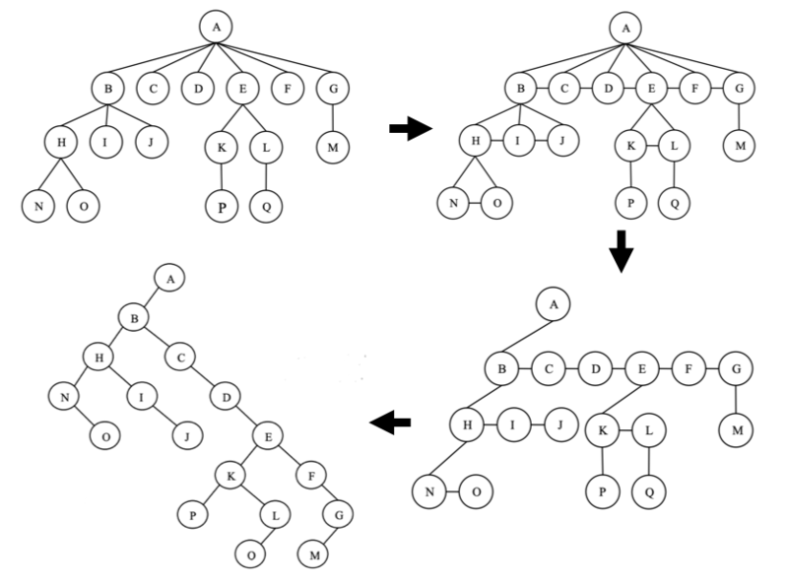
Convert a m-ary tree to binary tree

Slide 10
Converting m – ary Tree to Binary Tree
Steps for converting m – ary tree to binary tree
First, we link all the immediate children nodes of a given parent node together in order to form a link list.
Second, we keep the link from the parent to the first (i.e., the leftmost) child.
Third, Remove all the other links to the rest of the children.
Repeat this process for all the children (if they have any children) until we have processed all the internal nodes.
Rotate the tree by 45 degrees clockwise.
The tree obtained is the desired binary tree obtained from the given m-ary tree.

Slide 11
Thank You

